Slide 1
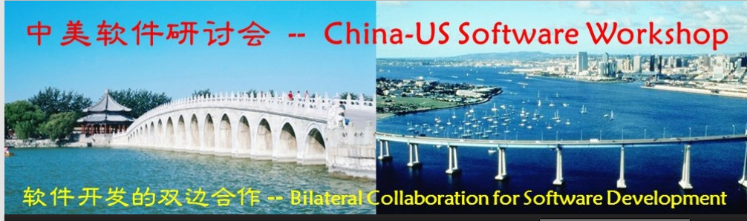
Beijing, September 25-27, 2011
Emerging Architectures Session
USA Research Summaries
Presented by Jose Fortes
Contributions by :
Peter Dinda, Renato Figueiredo, Manish Parashar, Judy Qiu, Jose Fortes

Slide 2
New Apps
New reqs
New tech
Enterprises
Social networks
Sensor Data
Big Science
E-commerce
Virtual reality
…
Big data
Extreme computing
Big numbers of users
High dynamics
…
Virtualization
P2P/overlays
User-in-the-loop
Runtimes
Services
Autonomics
Par/dist comp …
“New” Complexity
Abstractions
Emerging software architectures
Hypervisors, empathic, sensor nets, clouds, appliances, virtual networks, self-*, distributed stores, dataspaces, mapreduce…

Slide 3
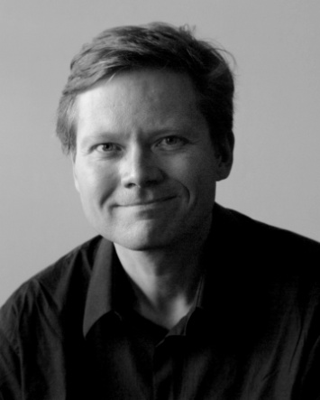


Peter Dinda, Northwestern University pdinda.org
Experimental computer systems researcher
General focus on parallel and distributed systems
V3VEE Project: Virtualization
Created a new open-source virtual machine monitor
Used for supercomputing, systems, and architecture research
Previous research: adaptive IaaS cloud computing
ABSYNTH Project: Sensor Network Programming
Enabling domain experts to build meaningful sensor network applications without requiring embedded systems expertise
Empathic Systems Project: Systems Meets HCI
Gauging the individual user’s satisfaction with computer and network performance
Optimizing systems-level decision making with the user in the loop
Notes:
Peter Dinda is a professor in the Department of Electrical Engineering and Computer Science at Northwestern University, and head of its Computer Engineering and Systems division, which includes 17 faculty members. He holds a B.S. in electrical and computer engineering from the University of Wisconsin and a Ph.D. in computer science from Carnegie Mellon University. He works in experimental computer systems, particularly parallel and distributed systems. His research currently involves virtualization for distributed and parallel computing, programming languages for parallel computing, programming languages for sensor networks, and empathic systems for bridging individual user satisfaction and systems-level decision-making.
In this talk, I will focus on three of Dinda’s current projects. The first project, known as the V3VEE project has build a new, open-source, publicly available virtual machine monitor, the Palacios VMM. Dinda, his collaborators, and students use Palacios to conduct research into supercomputing, cloud computing, language run-time, and computer architecture topics which can be best explored within the VMM layer.
The second project, the ABSYNTH project, focuses on programming languages, programming systems, and synthesis techniques to make high quality sensor network application development available to application scientists instead of just to embedded systems experts.
The third project I will focus on, the Empathic Systems Project, explores the use of direct user feedback to the systems and architecture layers to make possible individualized decision making, for example in cpu and system power management, cpu scheduling, network link scheduling, and many other areas. The core idea is the incorporate global feedback, from the users of computing and networking infrastructure, into the control algorithms that manage them. The advantage of this is to keep more users happy at a lower resource cost than would otherwise be possible.

Slide 4
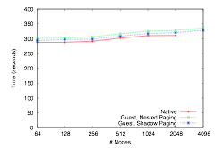
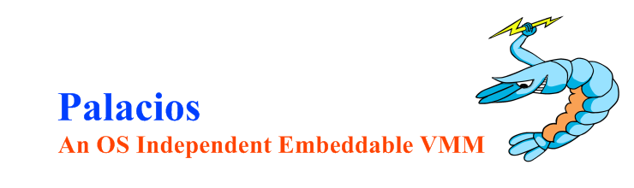
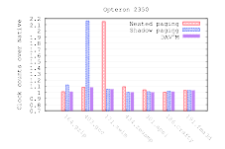
V3VEE: A New Virtual Machine Monitor
Peter Dinda (pdinda@northwestern.edu) Collaborators at U. New Mexico, U.Pittsburgh, Sandia, and ORNL
New, publicly available, BSD-licensed, open source virtual machine monitor for modern x86 architectures
Designed to support research in high performance computing and computer architecture, in addition to systems
Easily embedded into other OSes
Available from v3vee.org
Upcoming 4th release
Contributors welcome!
Palacios has <3% overhead virtualizing a large scale supercomputer
[Lange, et al, VEE 2011]
Adaptive paging provides the best of nested and shadow paging
Some of our own work using V3VEE Tools
Techniques for scalable, low-overhead virtualization of large-scale supercomputers running tightly coupled applications (top left)
Adaptive virtualization such as dynamic paging mode selection (bottom left)
Symbiotic virtualization: Rethinking the guest/VMM interface
Specialized guests for parallel run-times
Extending overlay networking into HPC
[Bae, et al,
ICAC 2011]
4
Notes:
The focus of the V3VEE project is on the design, implementation, and evaluation of new technologies for virtualization. A key contribution is Palacios, a new, publicly available, BSD-licensed, open source virtual machine monitor for modern x86 machines. Palacios is an embeddable VMM, meaning it can be incorporated into other operating systems. It is not paravirtualized, meaning it can run existing, unmodified OSes. Palacios is intended to support not just systems research, but also research in high performance computing and computer architecture.
Very shortly, the 4th release of Palacios will be available. Until then, you can examine the 3rd release (1.2) or our up-to-the-minute public development repository to see what will be included.
Contributors are always welcome to the V3VEE project. Current external contributors from outside the United States include researchers from the Russian Academy of Sciences and the Minix group in the Netherlands
We use Palacios and other tools developed within the V3VEE project to conduct a range of research, some of which is noted here. For example, we have developed a set of techniques for low overhead virtualization of supercomputers at large scales, even when they are running tightly coupled applications. The figure to the top right shows the results of a weak scaling study of Sandia’s CTH acceptance benchmark running on a Cray XT supercomputer at scales up to 4096 nodes, with and without virualization. The upshot is that our techniques achieve <3% overhead on this combination (and on a range of others). We are the first to demonstrate that it is feasible to virtualize a supercomputer at scale. This suggests that it will be possible to broaden the accessibility of even the largest capability supercomputers through virtualization, while not impeding their performance when used for the applications they were designed for.
A long running effort in Dinda’s group is an adaptive computing - making decisions at the virtualization layer to enhance unmodified applications. Here we highlight a recent result that adaptively selects the approach used for memory virtualization in Palacios, switching between nested paging and shadow paging as needed based on the application workload. This adaptive approach, called DAV^2M is able to achieve the best of both worlds, providing near native performance without any user effort. Furthermore, there are cases where DAV^2M is able to improve performance over both nested and shadow paging because it can adapt to a multi-phase workload.
Other work we have conducted in the context of V3VEE includes new approaches to architecting the guest OS / VMM interface for mutual benefit without affecting hardware compatibility. We call this new model symbiotic virtualization.
We also are investigating trimmed down guest environments with simplified semantics. The idea here is to find a guest interface that is appropriate for specific parallel language run-time systems as opposed to be being general purpose.
Finally, we have developed techniques for overlay networking support within Palacios that is able to achieve near-native throughput even on underlying 10 gbps networks. Our goal here is to extend our previous efforts on adaptive computing within distributed systems (the virtuoso project) down into the supercomputer itself. That work built on top of our VNET overlay network system. The key requirement to employ it is to make VNET performance-competitive with native even in tightly coupled high throughput / low latency environments.

Slide 5
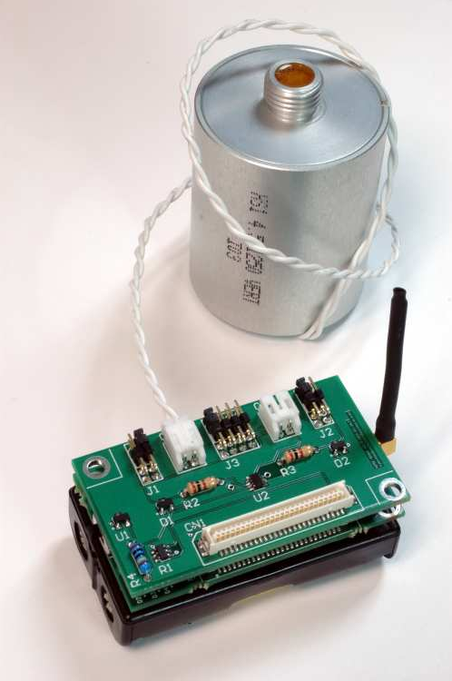
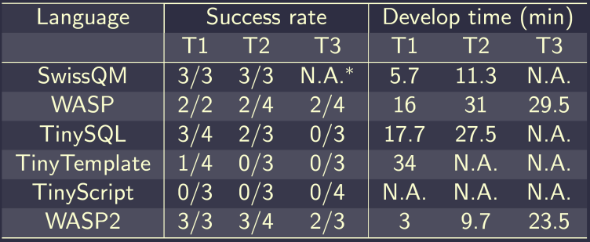
ABSYNTH: Sensor Network Programming For All
Peter Dinda (pdinda@northwestern.edu), collaborator: Robert Dick (U.Michigan)
Problem: Using sensor networks currently requires the programming, synthesis, and deployment skills of embedded systems experts or sensor network experts
How to we make sensor networks programmable by application scientists?
Four insights
Most sensor network applications fit into a small set of archetypes for which we can design languages
Revisiting simple languages that were previously demonstrably successful in teaching simple programming makes a lot of sense here
We can evaluate languages in user studies employing application scientists or proxies
These high-level languages facilitated automated synthesis of sensor network designs
WASP2 Archetype Language
Sensor BASIC Node Programming Language
BASIC was highly successful at teaching naive users (children) how to program in the ‘70s-‘80s. Sensor BASIC is our extended BASIC After a 30 minute tutorial, 45-55% of subjects with no prior programming experience can write simple, power-efficient, node-oriented sensor network programs. 67-100% of those matched to typical domain scientist expertise can do so.
The proposed language for our first identified archetype has high success rate and low development time in user study comparing it to other languages
[Miller, et al, SenSys 2009]
[Bai, et al, IPSN 2009]
5
Notes:
The Archtype-based Synthesis or ABSYNTH project is focused on making sensor network applications programmable by application domain scientists.
Outside of pre-configured applications, today’s sensor network hardware requires the skills of an embedded systems expert or a sensor network researcher to actually build a working application. This means that many potential users of sensor networks are ill served. For example, the photograph on the top left shows an off-the-shelf MicaZ mote that has been augmented by additional hardware, built by one of our students, that was necessary in order to create a seemingly quite simple power-efficient structural crack monitoring application in collaboration with a civil engineering group at Northwestern. While many sensor network application can be potentially described in a very simple manner and, indeed, are simple, this is superficial. The devil is in the details when it comes to power-efficient implementation, failure, deployment structures, etc.
Our project is based around the four insights noted in the upper right. These insights are generally self-explanatory, but it is important to point out that a key element of our evaluation of languages, programming systems, and synthesis tools is the use of user studies with subjects who either are domain scientists or who are skill-matched to domain scientists.
In the bottom half of the slide, we note two success stories from the project. First, on the bottom left, is the result of a user study on the WASP2 language, which we designed to support the most commonly occurring archetype for network-oriented (e.g., collective communication, aggregation) sensor network applications. Compared with alternative languages, the participants in our study were able to achieve a much higher success rate in carrying out common programming tasks (T1, T2, T3) in WASP2 and at a much lower development time. These subjects had minimal programming experience (matched to domain scientists) and studied a tutorial for the language used.
In the lower right, we note a success story fom another approach, that of employing languages that have demonstrated success elsewhere. Here, we consider the BASIC programming language, specifically the TinyBASIC variant that was highly successful in getting children to learn how to do simple programming on home computers in the 1970s and 80s. We extended this language with simple abstractions for power-efficient sensor network concepts. As the slide notes, this language achieved a remarkably high success rate. Even for users with no previous programming experience at all, 50% of them were able to write simple, power-efficient node-oriented sensor network programs after reading our tutorial for 30 minutes.

Slide 6
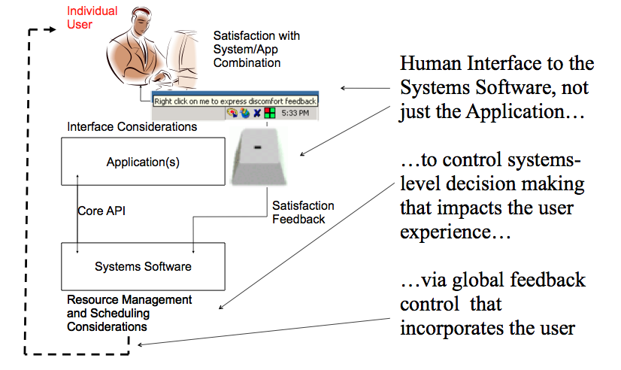
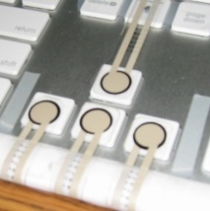
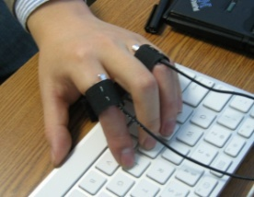
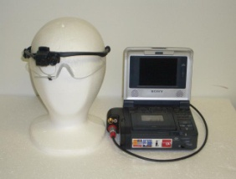
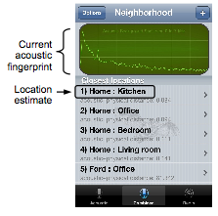
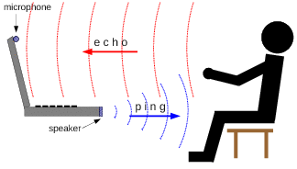
Empathic Systems Project: Systems Meets HCI
Peter Dinda (pdinda@northwestern.edu), Collaborators: Gokhan Memik (Northwestern), Robert Dick (U. Michigan)
Insights
Significant component of user satisfaction with any computing infrastructure depends on systems-level decisions (e.g. resource mgt.)
User satisfaction with any given decision varies dramatically across users
By incorporating global feedback about user satisfaction into the decision-making process we can enhance satisfaction at lower resource costs
Questions: how do we gauge user satisfaction and how do we use it in real systems?
Examples of User Feedback In Systems
Controlling DVFS hardware: 12-50% lower power than Windows [ISCA ’08, ASPLOS ’08, ISPASS ’09, MICRO ’08]
Scheduling interactive and batch virtual machines: users can determine schedules that trade off cost and responsiveness [SC ’05, VTDC ’06, ICAC ’07, CC ’08]
Speculative Remote Display: users can trade off between responsiveness and noise [Usenix ’08]
Scheduling home networks: users can trade off cost and responsiveness [InfoCom ’10]
Display power management: 10% improvement [ICAC ’11]
Gauging User Satisfaction With Low Overhead
Biometric Approaches [MICRO ’08, ongoing]
User Presence and Location
via Sound [UbiComp ’09, MobiSys ’11]
Notes:
In this project, we argue that computer systems researchers should
Incorporate user studies into the evaluation of systems
No such thing as the typical user
Variation in user satisfaction with given operating point is huge
Incorporate direct user feedback into the design of systems
No such thing as the typical user
Measure and leverage that high user variation
Our experience has shown that the insights noted in the top right appear to hold in many areas of systems and networking. Given those insights, we argue that computer system decision making (for example, scheduling, power management, and other forms of resource management) should be architected around a global feedback model that incorporates direct user feedback. This idea is illustrated schematically in the upper left.
Our work in the project generally takes two forms. The first is how to use direct user feedback about satisfaction in real systems. In the bottom right, we note some of our most successful applications of the idea, ranging from low-level control of CPU frequency and voltage to scheduling of interactive virtual machines and even home networks.
The second form of our work is in developing new approaches to cheaply measure user satisfaction with little to no cognitive load. It’s important to note that even a simple, one-bit feedback mechanism, for example a button to press when the user feels performance is suboptimal, buys an considerable amount of power. However, in the work illustrated in the bottom right, we show current work that aims at measuring satisfaction accurately without involving the user consciously at all. We have been able to demonstrate that using basic biometrics (force sensors on keys, galvanic skin response, and pupil dilation), we can determine when the user’s satisfaction with the computer system changes. In another strand of work, we have been able to use passive and active (sonar) acoustics to measure (a) user location to granularity of individual rooms, and (b) user presence and engagement.
It is our belief that biometric approaches to user satisfaction, and the clear benefits of using user satisfaction feedback, will eventually lead to using continuous individual user feedback in all aspects of computer systems and network control.

Slide 7

Renato Figueiredo - University of Florida byron.acis.ufl.edu/~renato
Internet-scale system architectures that integrate resource virtualization, autonomic computing, and social networking
Resource virtualization
Virtual networks, virtual machines, virtual storage
Distributed virtual environments; IaaS clouds
Virtual appliances for software deployment
Autonomic computing systems
Self-organizing, self-configuring, self-optimizing
Peer-to-peer wide-area overlays
Synergy with virtualization – IP overlays, BitTorrent virtual file systems
Social networking
Configuration, deployment and management of distributed systems
Leveraging social networking trust for security configuration
Notes:
What I’m trying to convey here is that the kind of “emerging architectures” that I am interested in are large-scale distributed systems that use resource virtualization as a basis for on-demand provisioning and management of computers, network and storage; autonomic/self-* techniques to cope with the complexity of managing (monitoring, configuration, resource control) such large virtual environments; and the applications of social networking infrastructures in the configuration and management of systems that have large numbers of end users.
This helps establish the theme that the other slides will build upon.

Slide 8
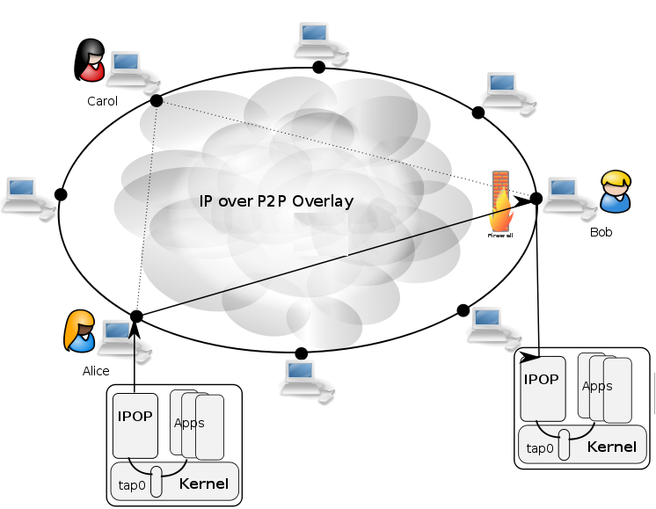
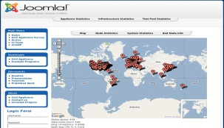
Self-organizing IP-over-P2P Overlays
Need: Secure VPN communication among Internet hosts is needed in several applications, but setup/management of VPNs is complex, costly for individuals small/medium businesses.
Objective: A P2P architecture for scalable, robust, secure, simple-to-manage VPNs Potential Applications: Small/medium business VPNs; multi-institution collaborative research; private data sharing among trusted peers
Approach:
Core P2P overlay: self-organizing structured P2P system provides a basis for resource discovery, dynamic join/leave, message routing and object store (DHT)
Decentralized NAT traversal: provides a virtual IP address space and supports hosts behind NATs – UDP hole punching or through a relay
IP-over-P2P virtual network: seamlessly integrates with existing operating systems and TCP/IP application software: virtual devices, DHCP, DNS, multicast
Software
Open-source user-level C# P2P library (Brunet) and virtual network (IPOP) – since 2006
http://ipop-project.org
Forms a basis for several systems: SocialVPN, GroupVPN, Grid Appliance, Archer,
Several external users and developers
Bootstrap overlay runs as a service on hundreds of PlanetLab resources
Notes:
Here the idea would be to begin by saying that at the core of these large-scale systems are overlays that are self-organizing, self-configuring, self-optimizing, scalable, and resilient to failures. This forms a basis for messaging among nodes in the system, data sharing, coordination, and for distributing computational tasks.
In particular, we have a unique system and software which implements IP-based virtual networks on top of a structured P2P overlay. This IP-over-P2P system provides a basis for communication among nodes while preserving the abstraction and interfaces of TCP/IP networks. Layered on top of the public Internet, and subject to constraints imposed by today’s Internet deployments(NAT, firewalls), the overlay provides the functionality of a virtual private network (VPN) without burdening administrators/users with the management of routing tables, private tunnel establishment, and NAT traversal.
It’d be good to convey that we have been developing and hardening software that does this for years, and that at this point we have a robust system that is used by several users and projects, including SocialVPN, Grid Appliance, Archer (which the next slides expand upon) and that we run overlay services on PlanetLab that facilitate users to deploy their own VPNs.

Slide 9

Social Virtual Private Networks (SocialVPN)
Need: Internet end-users can communicate with services, but end-to-end communication between clients is hindered by NATs and the difficulty to configure and manage VPN tunnels
Objective: Automatically map relationships established in online social networking (OSN) infrastructures to end-to-end VPN links
Potential Applications: collaborative environments, games, private data sharing, mobile-to-mobile applications
Overlay
Alice
Social
Carol
Bob
Approach:
IP-over-P2P virtual network: Build upon IPOP overlay for communication
XMPP messaging: Exchange of self-signed public key certificates; connections drawn from OSNs (e.g. Google) or ad-hoc
Dynamic private IPs, translation: No need for dedicated IP addresses, avoid conflicts of private address spaces
Social DNS: Allow users to establish and disseminate resource name-IP-mappings within the context of their social network
Software
Open-source user-level C# built upon IPOP; packaged for Windows, Linux
PlanetLab bootstrap
Web-based user interface
http://www.socialvpn.org
XMPP bindings: Google chat,
Jabber
1000s of downloads, 100s of concurrent users
Notes:
One of the highlighted applications of IPOP overlays is SocialVPN, where the basic idea is to map trust relationships taken from online social networking infrastructures, and automatically use them to establish and manage private communication channels between end users.
The P2P overlay provides a scalable communication fabric, but it is an open system where any node can join. SocialVPN ensures that, while you may share an open P2P overlay with untrusted users, that IP-layer communication is only established with your social peers, with end-to-end encryption and authentication based on well-known public key infrastructure (PKI) techniques.
The open-source software has bindings to popular online social networks (e.g. contacts on Google chat) and uses an open protocol (XMPP) which is supported by various open-source implementations (e.g. Jabber), so users can create their social VPNs from relationships established by third-party providers, or with their own private social network.

Slide 10
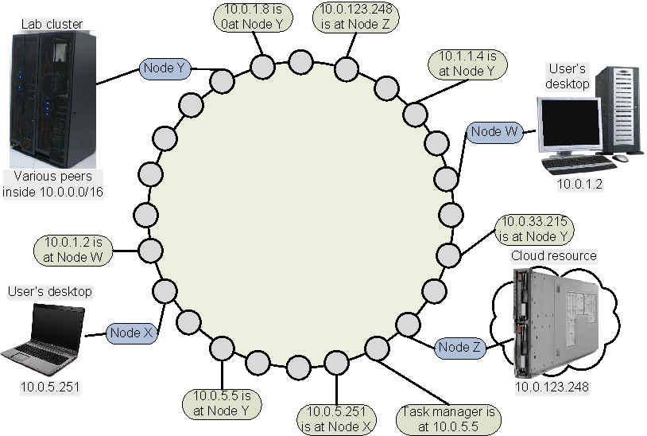
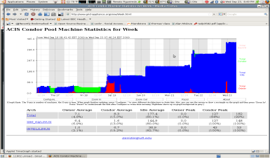
Grid Appliances – Plug-and-play Virtual Clusters
Need: Individual virtual computing resources can be deployed elastically within an institution, across institutions, and on the cloud, but the configuration and management of cross-domain virtual environments is costly and complex
Objective: Seamless distributed cluster computing using virtual appliance, networking, and auto-configuration of components
Potential Applications: Federated high-throughput computing, Desktop grids
Approach:
IP-over-P2P virtual network: Build upon IPOP overlay for communication
Scheduling middleware: Packaged in a computing appliance – e.g. Condor, Hadoop
Resource discovery and coordination: Distributed Hash Table (DHT), multicast
Web interface to manage membership: Allow users to create groups which map to private “GroupVPNs”, and assign users to groups; automated certificate signing for VPN nodes
Software
Packaging of open-source middleware (IPOP, Condor, Hadoop)
Runs on KVM, VMware, VIrtualBox – Windows, Linux, MacOS
Web-based user interface
http://www.grid-appliance.org
Archer (computer architecture)
FutureGrid (education/training)
Notes:
In this application of IP-over-P2P overlays, the goal is to enable plug-and-play distributed virtual clusters for high-throughput computing. Building upon machine virtualization and network virtualization, this system can create virtual clusters that are configured with a homogeneous software environment (O/S, libraries, ancilllry tools, software applications, middleware) and a homogeneous network environment (a private virtual network), which are instantiated on heterogeneous, distributed resources (e.g. clusters, desktops, cloud providers).
The “grid appliance” encapsulates all the software necessary to run a high-throughput computing stack (e.g. Linux with Condor and Hadoop), as well as software that self-configures nodes according to their role and membership in a trusted group.
The underlying overlay provided primitives for messaging, storage, and processing - a distributed hash table (DHT), IP unicast/multicast, and a layer that supports multicast query processing. Self-configuration scripts can build upon these primitives to organize virtual clusters, and configure their software.
The virtual cluster’s VPN uses a type of SocialVPN that is oriented towards groups – called GroupVPN. Here, users can create and manage memberships in their own groups using a Web interface, and appliances of users authorized to join a group automatically join a GroupVPN’s private network.
The appliances encapsulate open-source software (including IPOP), run on a variety of virtualization technologies, and have been used in practice in a number of projects by hundreds of users.

Slide 11

Manish Parashar nsfcac.rutgers.edu/people/parashar/
Science & Engineering at Extreme Scale
S&E transformed by large-scale data & computation
Unprecedented opportunities – however impeded by complexity
Data and compute scales, data volumes/rates, dynamic scales, energy
System software must address complexities
Research @ RU
RUSpaces: Addressing Data Challenges at Extreme Scale
CometCloud: Enabling Science and Engineering Workflows on Dynamically Federated Cloud Infrastructure
Green High Performance Computing
Many applications at scale
Combustion (exascale co-design), Fusion (FSP), Subsurface/Oil-reservoirs modeling, Astrophysics, etc.

Slide 12
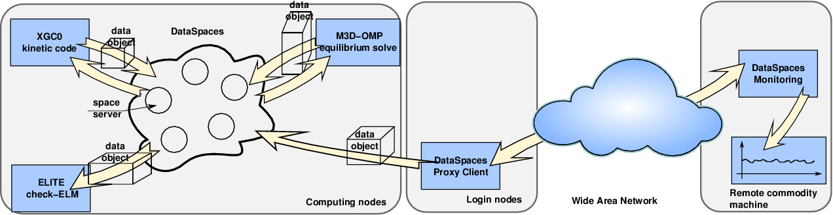
RUSpaces: Addressing Data Challenges at Extreme Scale
End-to-end Data-intensive Scientific Workflows at Scale
Motivation: Data-intensive science at extreme scale
End-to-end coupled simulation workflows - Fusion, Combustion, Subsurface modeling, etc.
Online and in-situ data analytics
Challenges: Application and system complexity
Complex and dynamic computation, interaction and coordination patterns
Extreme data volumes and/or data rates
System scales, multicores and hybrid many-core architectures, accelerators; deep memory hierarchies
The Rutgers Spaces Project: Overview
DataSpaces: Scalable interaction & coordination
Semantically specialized shared space abstraction
Spans staging, computation/accelerator cores
Online metadata indexing for fast access
DART: Asynchronous data transfer and communication
Application programming/runtime support
Workflows, PGAS, query engine, scripting
Locality-aware in-situ scheduling
ActiveSpaces: Moving code to data
Dynamic code deployment and execution
Current Status
Deployed on Cray, IBM, Clusters (IB, IP), Grids
Production coupled fusion simulations at scale on Jaguar
Dynamic deployment and in-situ execution of analytics
Complements existing programming systems and workflow engines
Functionality, performance and scalability demonstrated (SC’10) and published (HPDC’10, IPDPS’11, CCGrid’11, JCC, CCPE, etc.)
Team
M. Parashar, C. Docan. F. Zhang, T. Jin
Project URL
http://nsfcac.rutgers.edu/TASSL/spaces/
Notes:
End-to-end coupled scientific workflows t extreme scales, such as those occurring in the Fusion Simulation Project and the Combustion Exascale Co-Design Project, require dynamic coordination and exchange large data volumes. Traditional approaches used in workflow engines are based on files, and do no meet the performance and scalability requirements, and are not feasible at extreme scales.
DataSpaces is a scalable framework for enabling application coordination, interactions and data exchanges at runtime. It provides the abstraction of a distributed virtual shared-space with an in-memory data storage that can be associatively accessed by multiple applications asynchronously at runtime. DataSpaces can span multiple and heterogeneous resources, e.g., computing or staging cores, multiple core CPUs and GPUs to offer a uniform programming interface through a data query engine. It supports online metadata indexing for fast accesses and retrieval, and minimizes data transfers over the network using data services such as locality aware querying, applications co-scheduling, data processing at the sources, etc.
DataSapces builds on DART, which is a fast and asynchronous communication layer optimized for advanced communication networks available in current HPC machines (Cray-XT5, IBM BlueGene/P). DART also supports other interconnects (e.g., IBM – dcmf, InfiniBand, TCP).
ActiveSpaces is a programming and runtime system built on DataSpaces that support dynamic deployment of data processing kernels to where the data of interest is located and their in-situ execution. It minimizes data movement. The data processing routines (i.e., data kernels) can be written in high-level languages such as C. These kernels are typically smaller in size than the raw data they process. ActiveSpaces enables the DataSpaces to act as an accelerator for the computations, and this uses the resources more effectively.
The RU-Spaces approach has been used at scale in production run by real scientific codes (fusion, combustion, reservoir simulation, etc.), and has been demonstrated at different conferences. Related articles have been published at eHPDC’10, IPDPS’11, CCGrid’11, etc.

Slide 13

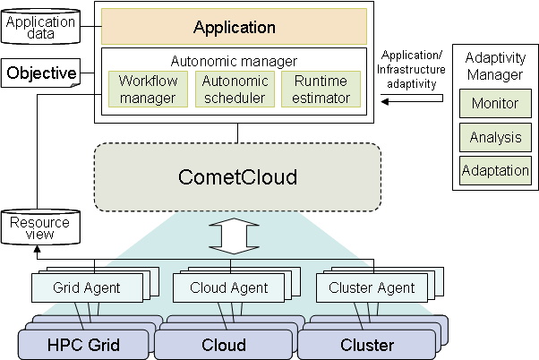
CometCloud: Enabling Science and Engineering Workflows on Dynamically Federated Cloud Infrastructure
Motivation: Elastic federated cloud infrastructures can transform science
Reduce overheads, improve productivity and QoS for complex application workflow with heterogeneous resource requirements
Enable new science-driven formulations and practices
Objective: New practices in science and engineering enabled by clouds
Programming abstractions for science/engineering
Autonomic provisioning and adaptation
Dynamic on-demand federation
Autonomic application management on a federated cloud
CometCloud: Autonomic Cloud Engine
Dynamic cloud federation: Integrate (public & private) clouds, data-centers and HPC grids
On-demand scale-up/down/out; resilience to failure and data loss; supports privacy/trust boundaries.
Autonomic management: Provisioning, scheduling, execution managed based on policies, objectives and constraints
High-level programming abstractions: Master/worker, Bag-of-tasks, MapReduce, Workflows
Diverse applications: business intelligence, financial analytics, oil reservoir simulations, medical informatics, document management, etc.
Current Status
Deployed on public (EC2), private (RU) and HPC (TeraGrid) infrastructure
Functionality, performance and scalability demonstrated (SC’10, Xerox/ACS) and published (HPDC’10, IPDPS’11, CCGrid’11, JCC, CCPE, etc.)
Supercomputing-as-a-Service using IBM BlueGene/P (Winner of IEEE SCALE 2011 Challenge)
Cloud abstraction used to support ensemble geo-system management workflow on a geographically distributed federation of supercomputers
Team
M. Parashar, H. Kim, M. AbdelBaky
Project URL
www.CometCloud.org
Notes:
A workflow is commonly used to describe the process of a scientific application, where a workflow consists of a sequence of stages. The stages have an order to run because the output of a stage becomes the input of the next stage. Besides, each stage is typically heterogeneous in terms of the length of computation and resource requirements. For example, one stage may run a computation-intensive application but the next stage may run a data-intensive application. Different stages may run the same application but the number of the tasks, the computational complexity and length of each task, its resource requirements etc., may vary. Since a scientific workflow has heterogeneous resource requirements, a single type of resource (cloud, grid, or cluster) may not satisfy its requirements and the type of resource required may not be know a priori. As a result, a dynamically federated cloud infrastructure can better provide appropriate resources and satisfy QoS requirements for complex application workflows with heterogeneous resource requirements. Furthermore, users may have additional time or budget constraints, and consequently, an elastic federated cloud infrastructure which scale up/down based on resource requirement is necessary.
The objective of this work is to enable new practices in science and engineering enabled by clouds. We provide 1) programming abstractions for science/engineering, 2) autonomic resource provisioning and adaptation on the federated cloud, 3) dynamic on-demand federation of clouds.
We are achieve these objectives using CometCloud, which is an autonomic cloud engine. CometCloud integrates different types of resource infrastructures (clouds/data centers/HPC grids), and federates and provisions resources based on policies, objectives, and constraints. It also provides high-level programming abstractions such as master/worker, MapReduce and workflow. We have deployed diverse applications such as business intelligence, financial analytics, oil reservoir simulations, medical informatics and document management, etc., using CometCloud on the federated cloud infrastructure.
We have also built a federated cloud composing Amazon EC2, Rutgers campus cluster and TeraGrid, and deployed the diverse applications on it. We demonstrated the functionality, performance and scalability at SC’10 and Xerox/ACS symposium and published papers in HPDC’10, IPDPS’11, CCGrid’11, JCC, CCPE, etc.). We demonstrated Supercomputer-as-a-service, achieved by federating BlueGene/P systems and abstracting them as a Cloud, at the in IEEE SCLAE 2011 (conjunction with CCGrid) and were awarded first place.

Slide 14

Green High Performance Computing (GreenHPC@RU)
Motivation: Power is a critical concern for HPC
Impacts operational costs, reliability, correctness
End-to-end integrated power/energy management essential
Objective:
Balance performance/utilization with energy efficiency
Application and workload awareness
Reactive and proactive approaches
Reacting to anomalies to return to steady state
Predict anomalies in order to avoid them
Cross-layer Architecture
GreenHPC@RU: Cross-Layer Energy-Efficient Autonomic Management for HPC
Application-aware runtime power management
Annotated Partitioned Global Address Space (PGAS) languages (UPC)
Targets Intel SCC and HPC platforms
Component-based proactive aggressive power control
Energy-aware provisioning, management
Power down subsystems when not needed; efficient just-right and proactive VM provisioning
Distributed Online Clustering (DOC) for online workload profiling
Energy and thermal management
Reactive and proactive VM allocation for HPC workloads
Current Status
Prototype of energy-efficient PGAS runtime in the Intel SCC many-core platform and ongoing at HPC cluster scale
Aggressive power management algorithms for multiple components and memory (HiPC’10/11)
Provisioning strategies for HPC on distributed virtualized environments (IGCC’10) and considering energy/thermal efficiency for virtualized data centers (E2GC2’10, HPGC’11)
Team
M. Parashar, I. Rodero, S. Chandra, M. Gamell
Project URL
http://nsfcac.rutgers.edu/GreenHPC
Notes:
Power consumption of high performance computing (HPC) platforms is becoming a major concern for a number of reasons including cost, reliability, energy conservation, and environmental impact. High-end HPC systems today consume several megawatts of power, enough to power small towns, and are in fact, soon approaching the limits of the power available to them.
Since an integral approach for autonomic energy-efficient management is extremely difficult, we consider a layered model (from physical environment to workload) that allows us to reduce complexity by addressing specific problems at different layers and integrating them using cross-layer approaches. The different layers work together proactively with the common goal of reducing the energy footprint of HPC systems with very small or no penalty in the performance. We consider application and workload awareness which is obtained by their profiling and characterization. We detect abnormal operational states (e.g., poor performance, hotspots) and implement both reactive and proactive approaches (i.e., modeling and prediction) to return to steady state.
We have explored four associated problems or directions:
- We addressed runtime power management for PGAS languages such as UPC in platforms with advanced power control such as the Intel SCC or HPC clusters.
- We studied aggressive power management for multiple systems including CPU, memory, disk and network. We did further research on the memory subsystems based on DVFS and memory channel affinity of HPC benchmarks.
- We used Distributed Online Clustering to characterize the workload and provision VM accurately (fine grain VM classes) and allocate them in resources with lowest energy footprint – based on power control at the system level (powering down subsystems when they were not needed).
- We also combined energy-efficient VM provisioning and consolidation with thermal awareness. We explored the correlation between energy and temperature to implement policies.
We have developed and evaluated strategies for aggressive power management of multiple components and for VM provisioning and management in virtualized environments. We used both simulations and empirical experiments in actual hardware for our evaluations.
We also have implemented a PGAS runtime prototype in the experimental Intel SCC many-core platform, which is our current main focus.
Our research has resulted in several papers in high quality conferences, book chapters and workshops. Various journal articles are currently under submission or elaboration.

Slide 15




Judy Qiu, Indiana University www.soic.indiana.edu/people/profiles/qiu-judy.shtml
Cloud programming environments
Iterative MapReduce (e.g. for Azure)
Data-intensive computing
High-Performance Visualization Algorithms For
Data-Intensive Analysis
Science clouds
Scientific Applications Empowered by HPC/Cloud

Slide 16
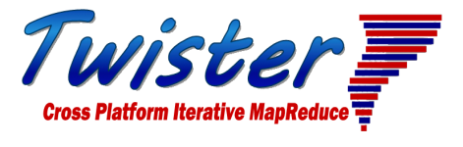
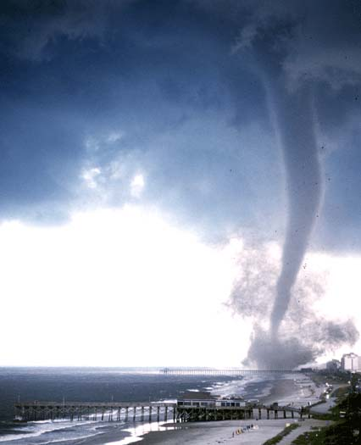
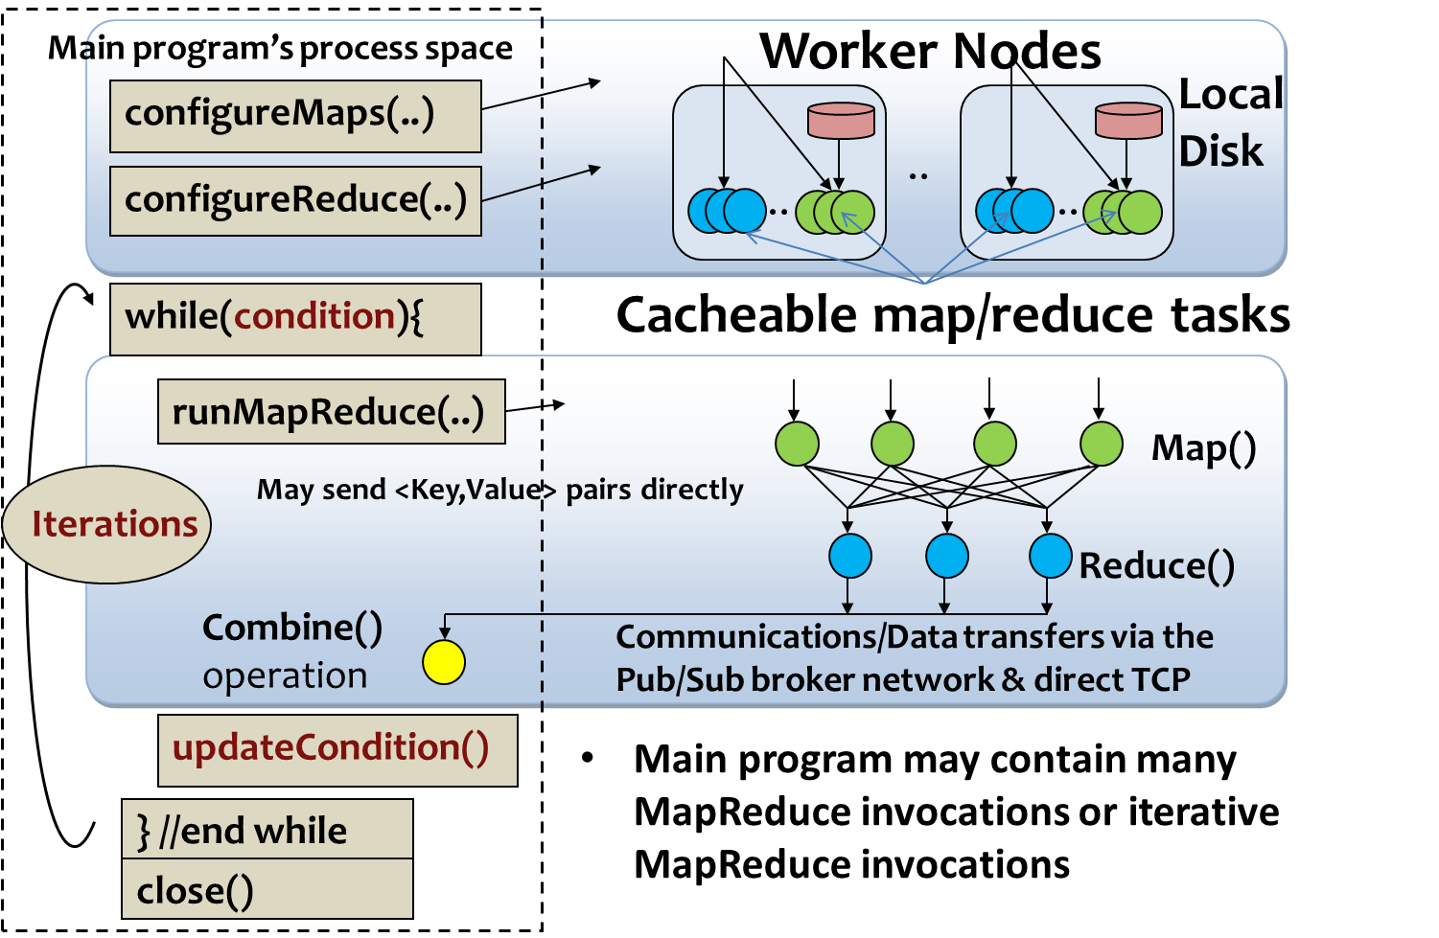

Enabling HPC-Cloud interoperability
NSF OCI-1032677 (Co-PI), start/end year: 2010/2013
PI: Judy Qiu, Funding: Indiana University's Faculty Research Support Program, start/end year: 2010/2012 Microsoft Foundation Grant, start year: 2011
New Infrastructure for
Iterative MapReduce Programming
Approach
Distinction between static and variable data
Configurable long running (cacheable) Map/Reduce tasks
Combine phase to collect all reduce outputs
Publish/Subscribe messaging based communication
Data access via local disks
Future
Map-Collective and Reduce-Collective models by user customizable collective operations
A scalable software message routing using Publish/Subscribe
A fault tolerance model that supports checkpoints between iterations and individual node failure
A higher-level programming model
Motivation
Expands the traditional MapReduce Programming Model
Efficiently supports Expectation-maximization (EM) iterative algorithms
Supports different computing environments, e.g., HPC, Cloud
Progress to Date
Applications: Kmeans Clustering, Multidimensional Scaling, BLAST, Smith-Waterman dissimilarity distance calculation…
Integrated with TIGR workflow as part of bioinformatics services on TeraGrid ‒ a collaboration with Center for Genome and Bioinformatics at IU supported by NIH Grant 1RC2HG005806-01
Tutorials used by 300+ graduate students across the nation of 10 universities in the NCSA Big Data for Science Workshop 2010 and 10 HBCU Institutes in ADMI Cloudy View workshop 2011
Used in IU graduate level courses
Funded by Microsoft Foundation Grant, Indiana University's Faculty Research Support Program and NSF OCI-1032677 Grant
Notes:
Background:
Clouds provide both cost effectiveness and powerful parallel programming paradigms.
On the other hand HPC clusters spanning up to exascale capability will continue to be critical.
A key challenge is portability not just as systems scale up in size but also between HPC and Cloud systems, in addition to common challenges in fault tolerance and storage.
Iterative MapReduce (as illustrated by Pregel and Twister) are a basis to address the above challenges as they interpolate between the traditional tightly coupled MPI jobs typical of supercomputers, and the more loosely coupled information retrieval and pleasingly parallel (“map only”) applications typical of clouds and high throughput systems. It will provide an unified programming paradigm and prove very important for data analysis of science applications.
Bottom right:
Programming model of Twister. Note that iterations is emphasized. The left side is the main program’s process space, there you can configure static data and cache them into map tasks or reduce tasks, and then you can have iterations to run MapReduce jobs. You also can use Combine method to get the iteration results back to main program from work nodes.

Slide 17
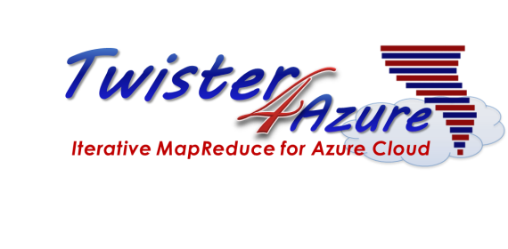
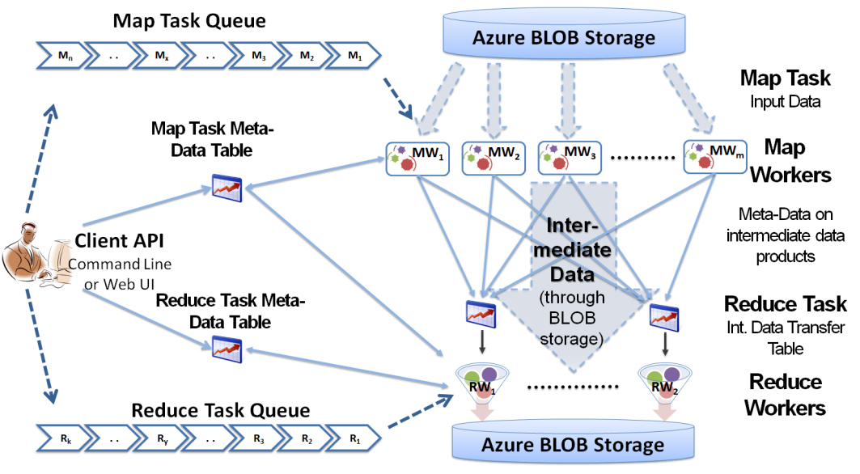
Iterative MapReduce for Azure
PI: Judy Qiu, Funding: Microsoft Azure Grant, start/end year: 2011/2013, Microsoft Foundation Grant, start year: 2011
Motivation
Tailoring distributed parallel computing frameworks for cloud characteristics to harness the power of cloud computing
Objective
To create a parallel programming framework specifically designed for cloud environments to support data intensive iterative computations.
Future Works
Improve the performance for commonly used communications patterns in data intensive iterative computations.
Performing micro-benchmarks to understand bottlenecks to further improve the iterative MapReduce performance.
Improving the intermediate data communication performance by using direct and hybrid communication mechanisms.
Approach
Designed specifically for cloud environments leveraging distributed, scalable and highly available cloud infrastructure services as the underlying building blocks.
Decentralized architecture to avoid single point of failures
Global dynamic scheduling for better load balancing
Extend the MapReduce programming model to support iterative computations.
Supports data broadcasting and caching of loop-invariant data
Cache aware decentralized hybrid scheduling of tasks
Task level MapReduce fault tolerance
Supports dynamically scaling up and down of the compute resources
Progress
MRRoles4Azure (MapReduce Roles for Azure Cloud) public release on December 2010.
Twister4Azure, iterative MapReduce for Azure Cloud, beta public release on May 2011.
Applications: KMeansClustering, Multi Dimensional Scaling, Smith Waterman Sequence Alignment, WordCount, Blast Sequence Searching and Cap3 Sequence Assembly
Performance comparable or better compared to traditional MapReduce run times (eg. Hadoop, DryadLINQ) for MapReduce type and pleasingly parallel type applications
Outperforms traditional MapReduce frameworks for Iterative MapReduce computations.
Notes:
Top Left:
Structure of Twister4Azure. Uses Azure Queues for map/reduce task scheduling, Azure Blob storage for input/output/intermediate data storage, Azure Tables for meta-data/monitoring data storage
Features:
Distributed, highly scalable and highly available cloud services as the building blocks.
Utilize eventually-consistent , high-latency cloud services effectively to deliver performance comparable to traditional MapReduce runtimes.
Decentralized architecture with global queue based dynamic task scheduling
Minimal management and maintenance overhead
Supports dynamically scaling up and down of the compute resources.
MapReduce fault tolerance

Slide 18
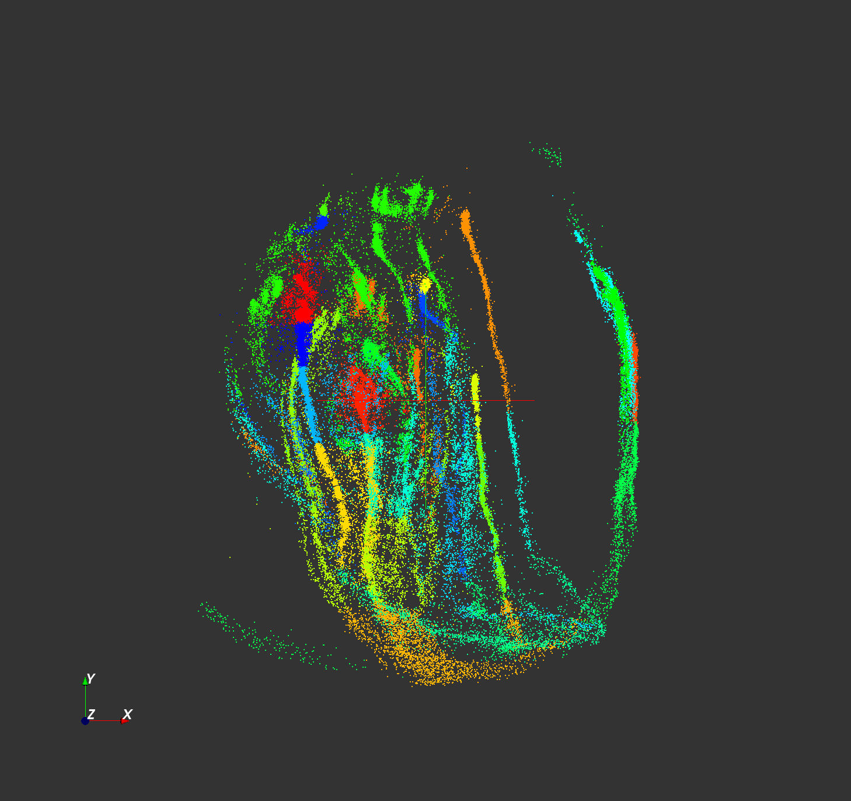
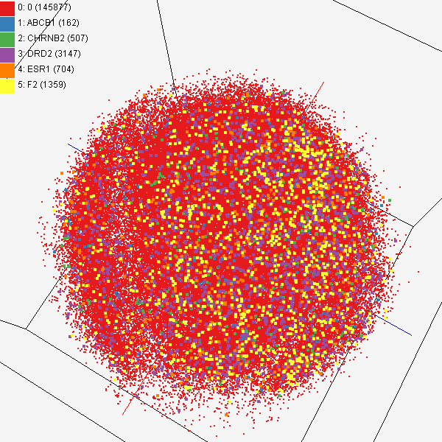
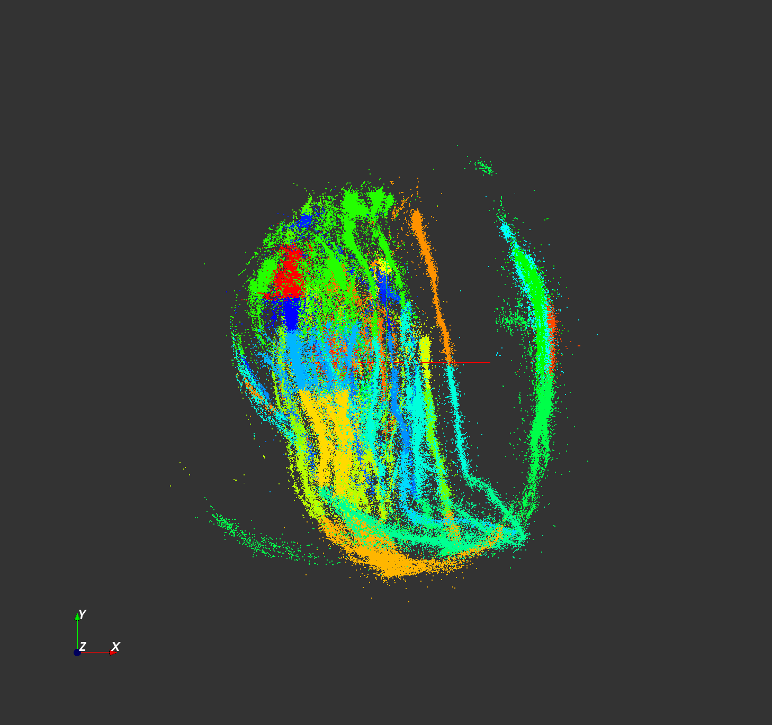
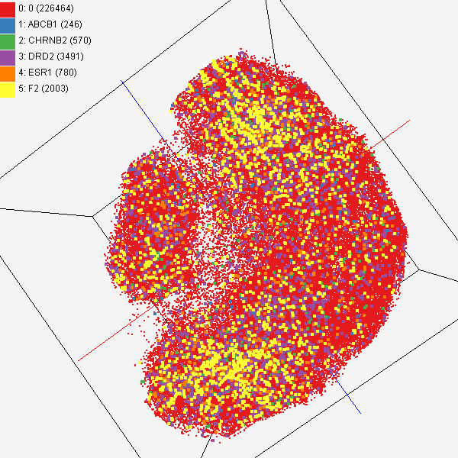
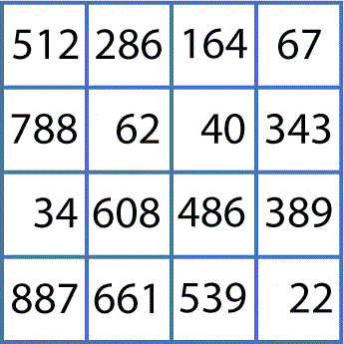


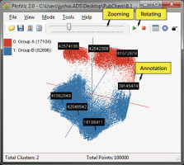
Scientific Applications Empowered by HPC/Cloud
Co-PI: Judy Qiu, Funding: NIH Grant 1RC2HG005806-01 start/end year: 2009/2011
Million Sequence Challenge
Clustering for 680,000 metagenomics sequences (front) using MDS interpolation with 100,000 in-sample sequences (back) and 580,000 out-of-sample sequences.
Implemented on PolarGrid from Indiana University with 100 compute nodes, 800 MapReduce workers.
Chemical compounds shown in literatures, visualized by MDS (top) and GTM (bottom)
Visualized 234,000 chemical compounds which may be related with a set of 5 genes of interest (ABCB1, CHRNB2, DRD2, ESR1, and F2) based on the dataset collected from major journal literatures which is also stored in Chem2Bio2RDF system.
Simple Bioinformatics Pipeline
PlotViz, Visualization System
Gene Sequences
Pairwise Alignment & Distance Calculation
O(NxN)
O(NxN)
Parallel Visualization Algorithms
PlotViz
Multi-Dimensional Scaling
Parallel visualization algorithms (GTM, MDS, …)
Improved quality by using DA optimization
Interpolation
Twister Integration (Twister-MDS, Twister-LDA)
Provide Virtual 3D space
Cross-platform
Visualization Toolkit (VTK)
Qt framework
Coordinates
3D Plot
Visuali-
zation
O(NxN)
Cluster Indices
Pairwise Clustering
Notes:
Top:
Scientific applications implemented with Twister. It is funded by NIH.
Bottom Left:
The goal of our bioinformatics pipeline is to apply clustering to proteomics and metagenomics data, providing scientists with a visual means for drawing conclusions about the relationships among large sets of biosequences. The process begins by calculating genetic dissimilarities for a sample of sequences, which produces an NxN distance matrix. This matrix is then fed to MDS and Pairwise Clustering (PWC) software in order to transform the sample space from high dimensions (D=20 or greater) to 3 dimensions and to generate clustering, or grouping, labels for the sequences. Finally, PlotViz reads the MDS coordinates and PWC data to render a 3D plot of the clustered and color-coded sequence sample space.
(Original text below)
Bioinformatics Pipeline. It’s an example of overall view on how data is processed and calculated in this area. Our group has ability to perform the entire pipeline.
Gene sequence ---(Pairwise Alignment and Distance Calculation) --→ distance matrices –(MDS, GTM or Pairwise clustering)→ visualization –(PlotViz)→ 3D Plot
Bottom Right:
PlotViz3 - a cross-platform data point visualization tool. PlotViz is a 3D data point browser that visualizes large volume of 2- or 3-dimensional data as points in a virtual space on a computer screen and enable users to explore the virtual space interactively. PlotViz was initially designed to consume outputs of dimension reduction algorithms for visualizing high-dimensional data in a lower-dimensional space, such as Multi-dimensional Scaling (MDS) and Generative Topographic Mapping (GTM).

Slide 19
High-Performance Visualization Algorithms
For Data-Intensive Analysis
Co-PI: Judy Qiu (xqiu@indiana.edu) Funding: NIH Grant 1RC2HG005806-01 Collaborators: Haixu Tang (hatang@indiana.edu ) start/end year: 2009/2011
Generative Topographic Mapping
Multi Dimensional Scaling (MDS)
Motivation
Discovering information in large-scale datasets is very important and large-scale visualization is highly valuable
A non-linear dimension algorithm, GTM (Generative Topographic Mapping), for large-scale data visualization through dimension reduction.
Objective
Improve traditional GTM algorithm to achieve more accurate results
Implementing distributed and parallel algorithms with efficient use of cutting-edge distributed computing resources
Motivation
Make possible to visualize millions of points in human-perceivable space
Help scientist to investigate data distribution and property visually
Objective
Implement scalable high performance MDS to visualize millions of points in lower dimensional space
Solve the local optima problem of MDS algorithm to get better solution.
MDS Mapping Example
Approach
Apply a novel optimization method called Deterministic Annealing and develop a new algorithm DA-GTM (GTM with Deterministic Annealing)
A parallel version of DA-GTM based on Message Passing Interface (MPI)
Approach
Parallelization via MPI to utilize distributed memory system for obtaining large amount of memory and computing power
New approximation method to reduce resource requirement
Apply Deterministic Annealing (DA) optimization method in order to avoid local optima
Progress
Parallelization shows high efficient implementation.
MDS Interpolation reduces time complexity from O(N²) to O(nM), which result in mapping of millions of points.
DA-SMACOF finds better quality mappings and even efficient.
Applied to real scientific applications, i.e. PubChem and BioInformatics.
Future
High efficient hybrid parallel MDS.
Adaptive cooling mechanism for DA-SMACOF
Progress
Globally optimized low-dimensional embedding
Used in various science applications, like PubChem
Future
Apply to other scientific domains
Integrate to other systems with monitor in a user friendly interface
DA-GTM / GTM-Interpolation
Parallel HDF5
ScaLAPACK
MPI / MPI-IO
Parallel File System
Cray / Linux / Windows Cluster
DA-GTM Software Stack
Notes:
Both GTM and MDS are:
Non-linear dimension reduction
Find an optimal configuration in a lower-dimension
Improve traditional iterative optimization method (EM) by using a noble optimization called DA (Deterministic Annealing)
Time complexity of GTM is O(KN) (K<<N), and MDS is O(N^2)
Input for GTM is vector based data.
Input for MDS is Pairwise similarity matrix as well as vector based data.
Top Right
The figure shows the mapping result of 30,000 biological sequence data via MDS based on pairwise sequence alignment. It shows clusters colored separately.
Bottom Right
O(nM) → where n = sample size, and M = N – n.

Slide 20
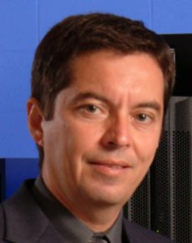
José Fortes - University of Florida
Systems that integrate computing and information processing and deliver or use resources, software or applications as services
Cloud/Grid-computing middleware
Cyberinfrastructure for e-science
Autonomic computing
FutureGrid (OCI-0910812)
iDigBio (EF-1115210)
Center for Autonomic Computing (IIP-0758596)

Slide 21
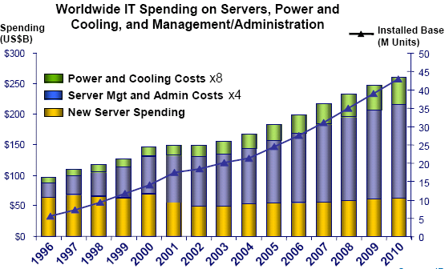
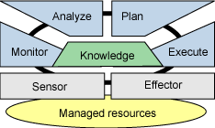
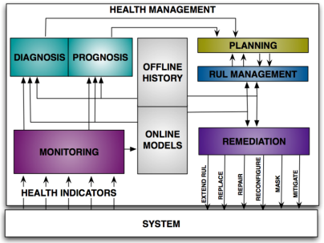
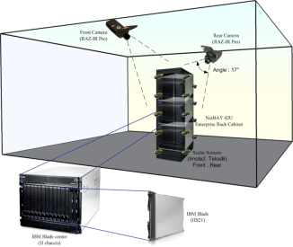
Center for Autonomic Computing
Industry-academia research consortium funded by NSF awards, industry member fees and university funds
PIs: José Fortes, Renato Figueiredo, Manish Parashar, Salim Hariri, Sherif Abdelwahed and Ioana Banicescu
Center Overview
Universities: U. Florida, U. Arizona, Rutgers U., Mississipi St. U.
Industry members: Raytheon, Intel, Xerox, Citrix, Microsoft, ERDC, etc
Technical Thrusts in IT Systems:
Performance, power and cooling
Self-protection
Virtual networking
Cloud and grid computing
Collaborative systems
Private networking
Application modeling for policy-driven
management
Autonomic computing: Introduction and Need
Need: Increasing operational and management costs of IT systems
Objective: Design and develop IT systems with Self-* Properties:
Self-optimizing: Monitors and tunes resources
Self-configuring: Adapts to dynamic environment
Self-healing: Finds, diagnoses and recovers from disruptions
Self-protecting: Detects, identifies and protects from attacks
Project 1: Datacenter Resource Management
Controllers predict + provision virtual resources for applications
Multiobjective optimization (30% faster with 20% less power)
Use fuzzy logic, genetic algorithms and optimization methods
Use cross-layer information to manage virtualized resources to minimize power, avoid hot spots and improve resource utilization
Project 2: Self-Caring IT systems
Goal: Proactively manage degrading
health in IT systems by leveraging
virtualized environments, feedback
control techniques and machine learning.
Case Study: MapReduce applications
executing in the cloud. (Decrease penalty due
to single-node crash by up to 78%)
Project 3: Cross Layer Autonomic Intercloud Testbed
Goal: Framework for cross-layer optimization studies
Case Study: Performance, power consumption and
thermal modeling to support multiobjective
optimization studies.
Notes:
Begin with what the center is and what it does: An industry-academia research consortium funded by NSF, indistry members and university funds.
Motivation for the field of autonomic computing?

Slide 22
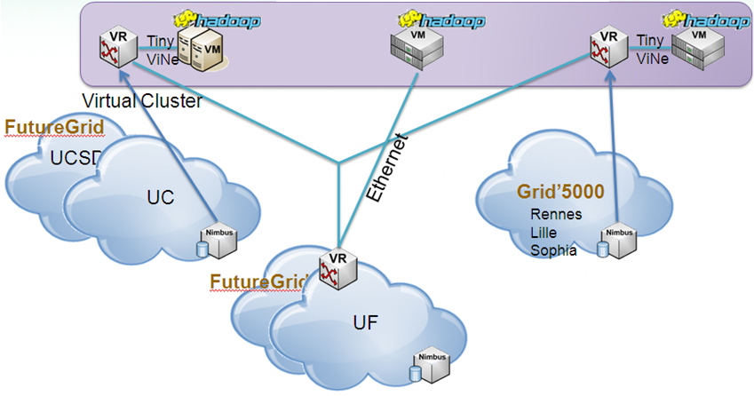
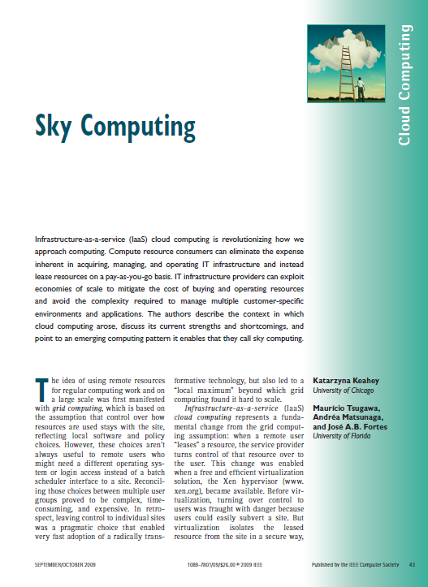
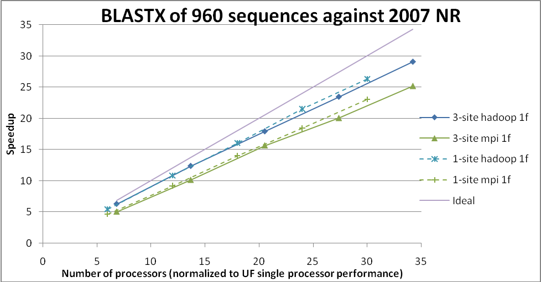
FutureGrid – Intercloud communication
PIs: Geoffrey Fox, Shava Smallen, Philip Papadopoulos, Katarzyna Keahey, Richard Wolski, José Fortes, Ewa Deelman, Jack Dongarra, Piotr Luszczek, Warren Smith, John Boisseau, and Andrew Grimshaw Funded by NSF
Need: Enable communication among cloud resources overcoming limitations imposed by firewalls, and have simple management features so that non-expert users can use, experiment, and program overlay networks.
Objective: Develop an easy to manage intercloud communication infrastructure, and efficiently integrate with other cloud technologies to enable the deployment of intercloud virtual clusters
Case Study: Successfully deployed a Hadoop virtual cluster with 1500 cores across 3 FutureGrid and 3 Grid’5000 clouds. The execution of CloudBLAST achieved speedup of 870X.
http://futuregrid.org
Managed user-level virtual network architecture: overcome Internet connectivity limitations [IPDPS’06]
Performance of overlay networks: improve throughput of user-level network virtualization software [eScience’08]
Bioinformatics applications on multiple clouds: run a real CPU intensive application across multiple clouds connected via virtual networks [eScience’08]
Sky Computing: combine cloud middleware (IaaS, virtual networks, platforms) to form a large scale virtual cluster [IC’09, eScience’09]
Intercloud VM migration [MENS’10]
CloudBLAST performance
ViNe Middleware http://vine.acis.ufl.edu
Open-source user-level Java program
Designed and implemented to achieve low overhead
Virtual Routers can be deployed as virtual appliances on IaaS clouds; VMs can be easily configured to be members of ViNe overlays when booted
VRs can process packets at rates over 850 Mbps
Exp. | Clouds | Cores | Speedup
1 | 3 | 64 | 52
2 | 5 | 300 | 258
3 | 3 | 660 | 502
4 | 6 | 1500 | 870

Slide 23
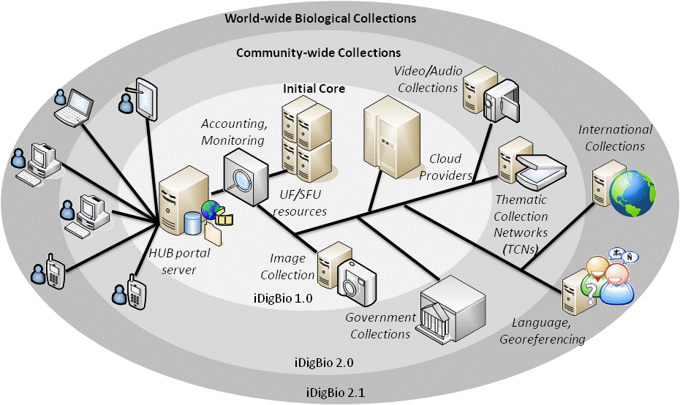

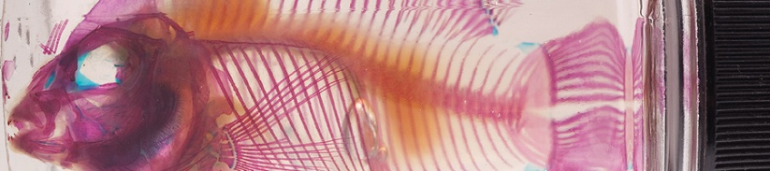
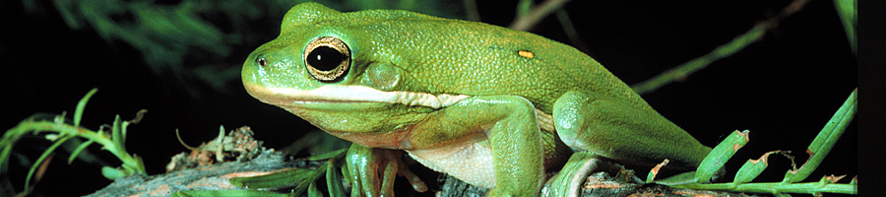
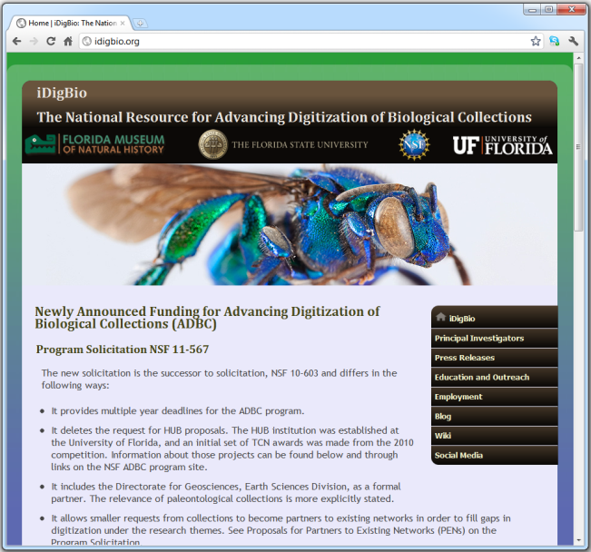
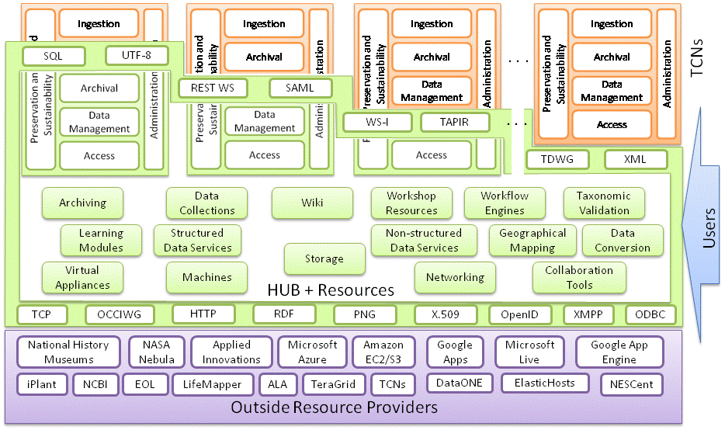
iDigBio - Collections Computational Cloud
PIs: Lawrence Page, Jose Fortes, Pamela Soltis, Bruce McFadden, and Gregory Riccardi Funded by NSF
The Home Uniting Biocollections (HUB) funded by the NSF Advancing Digitization of Biological Collections program
Need: Software appliances and cloud computing to adapt and handle diverse tools, scenarios and partners involved in digitization of collections
Objective: “virtual toolboxes” which, once deployed, enable partners to be both providers and consumers of an integrated data management/processing cloud
Case study: data management appliances with self-contained environments for data ingestion, archival, access, visualization, referencing and search as cloud services
Approach: Cloud-oriented appliance-based architecture
Now
iDigBio website: http://idigbio.org/
Wiki and blog tools
Storage provisioning based on Openstack
In 5 to 10 years
Library of Life consisting of vast taxonomic, geographical and chronological information in institutional collections on biodiversity.

Slide 24
New Apps
New reqs
New tech
Enterprises
Social networks
Sensor Data
Big Science
E-commerce
Virtual reality
…
Big data
Extreme computing
Big numbers of users
High dynamics
…
Virtualization
P2P/overlays
User-in-the-loop
Runtimes
Services
Autonomics
Par/dist comp …
“New” Complexity
Abstractions
Emerging software architectures
Hypervisors, empathic, sensor nets, clouds, appliances, virtual networks, self-*, distributed stores, dataspaces, mapreduce…

